Slide 1
GPS Sensor Ravneet Singh

Slide 2
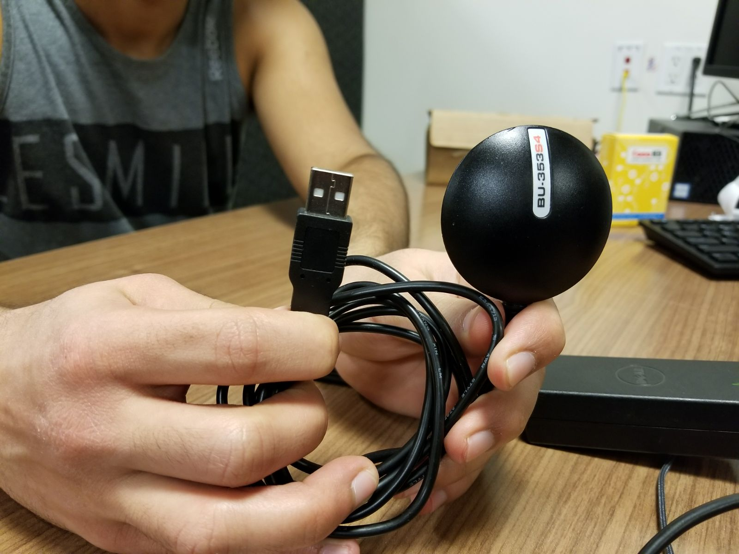
Introduction…
I am using GPS sensor for my project for the following reasons:
I have past experience working with this sensor for android.
The sensor is easily available and also reads altitude.
Easy to connect with the raspberry pi.

Slide 3
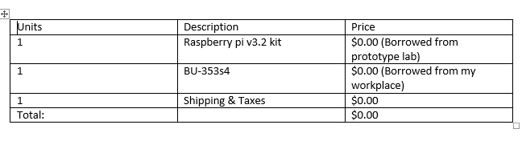
BUDGET….

Slide 4
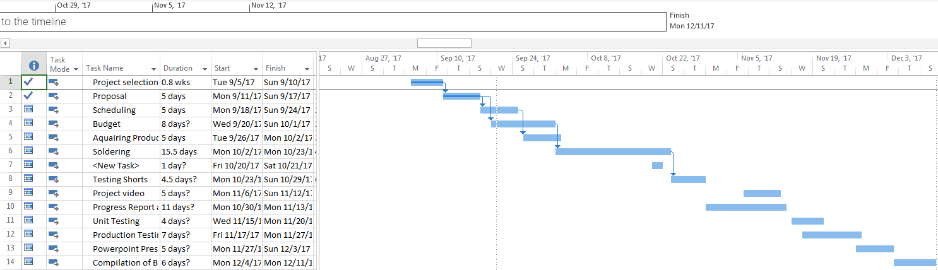
SCHEDULE….

Slide 5
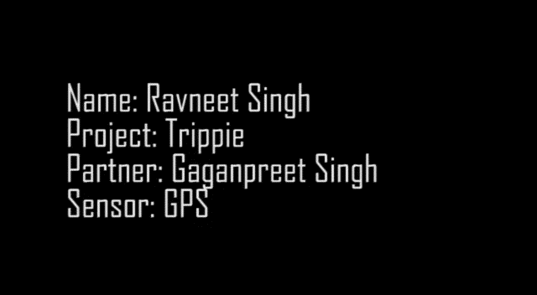
BUILD VIDEO…..

Slide 6
PREVIOUS COURSE KNOWLEDGE…..
I have experience using this USB GPS receiver during my summer job. I was familiar with the product and the results that it produce.
TECH 153 – This course was important as it familiarized me with raspberry pi’s raspbian environment and how to code in it.

